Slide 1

ELECTRONICS 101
VOLTAGE AND CURRENT

Slide 2


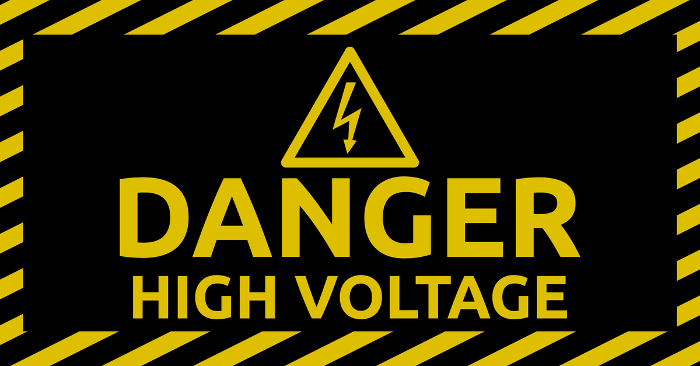
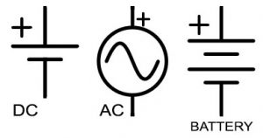
WHAT IS VOLTAGE
A “force” that drives the electricity forward or backward
Without voltage, there would be no electricity
There are voltage sources such as batteries and bench power supplies
Volt(s) is the unit to measure voltage (V)
Ex. 9V
Symbols for voltage source

Slide 3


WHAT IS CURRENT
Current is the flow of electricity
Electricity flows like a river but on wires
Conventional Current Flow (going from + to - )
Without voltage, current cannot flow
Amp(s) is the unit to measure current (A)
Ex. 2.5A
Symbols for current Source

Slide 4

WHAT IF VOLTAGE AND CURRENT FUSE TOGETHER
Power is formed
P = I*V
Watts is the unit to measure power (W)
Ex. 60W

